Slide 1

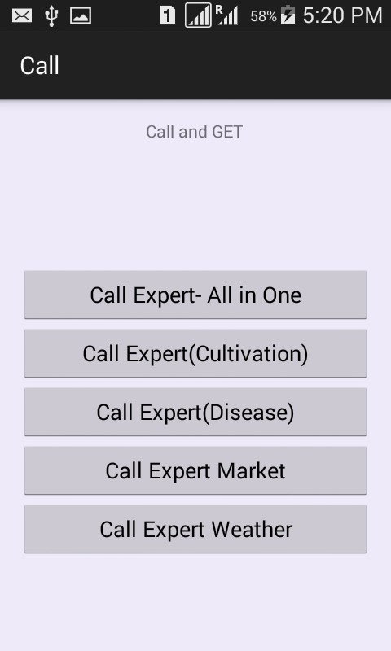
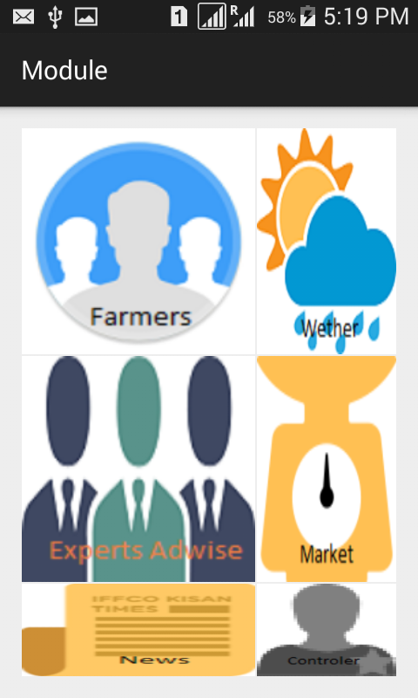
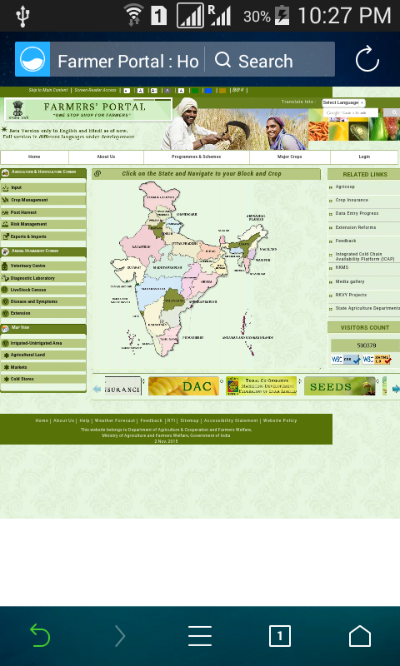
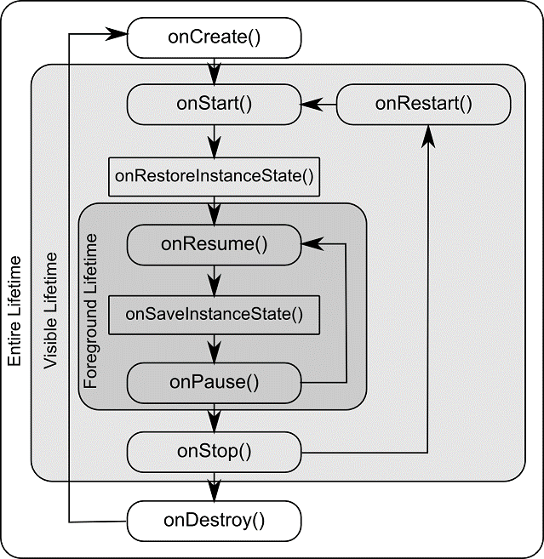
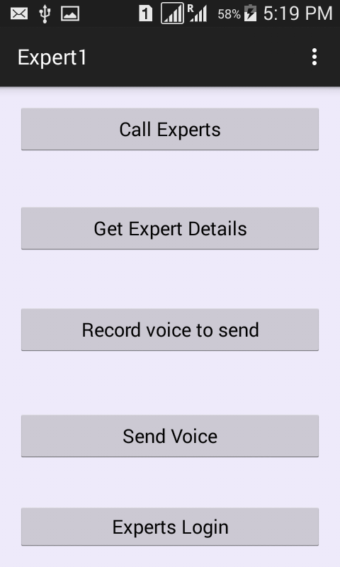
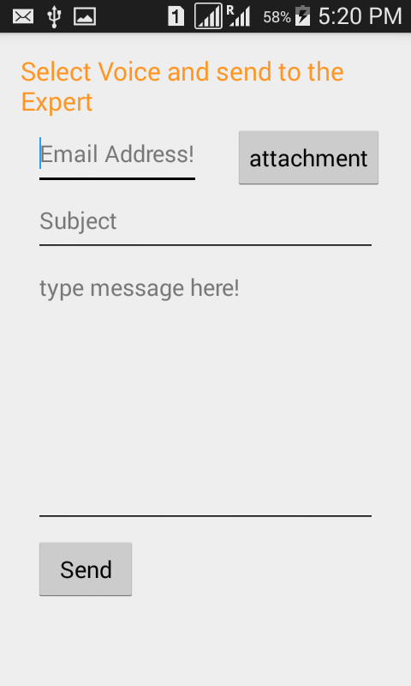
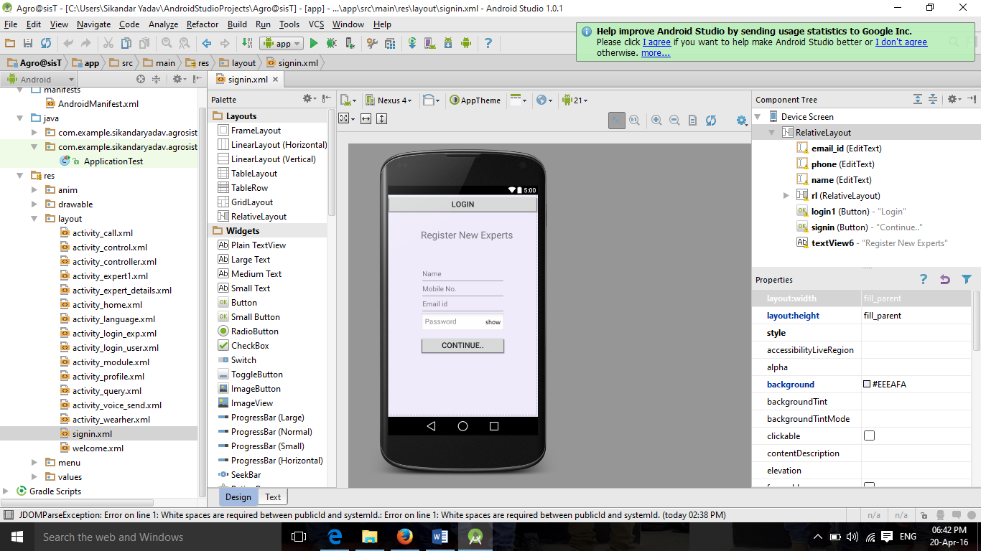
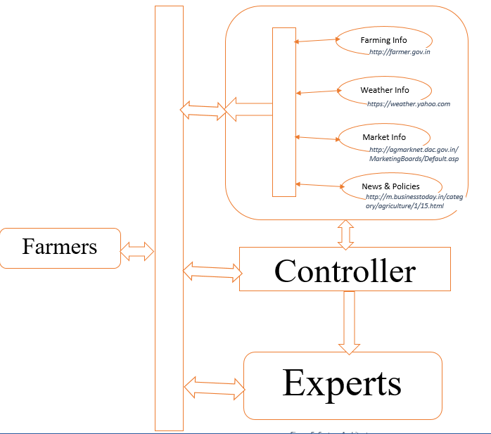
A Web Based Solution System For Indian Farmers, “Agro@ssisT”
Sikandar Yadav(14MCA0153) | Anitha A (Assistant Prof. (Senior)) | SITE, VIT
Motivation/ Introduction
Results
This system is designed to overcome the drawback of the existing system which are is in used but it’s not giving better impact to the users, so that I have selected this idea if for my final project that will provide the good impact on the users as well as for me in learning the technology that I’m going to use in this system.
With this proposed system I have been providing the facilities to connect the agro experts people with the formers , agro experts people will be authorized by administrator of this system and anyone can ask question from them directly whatever problems they are facing.
I have suggested the way by which the farmers can get expert advice. That method is given in the following.
There are several icon given to the user/farmers, so they can select any one from the given icon according to needs. See the following module wise description in iconic form.
Direct call method (Between experts and farmers).
Several categories of experts provided to the farmers.
Email method communications.
Voice sharing methods for communications.
Weather coasting information provided to the farmers.
Market News portal provided to the farmers.
Business News portals provided to the farmers.
Farming portal provided to the farmers.
Base of communication is mobile device
SCOPE of the Project
This proposed idea will help the farmers to get information regarding farming in very simple and interactive way. It will encourage the farmer and it’ll provide platform by which they can solve many farming problem like cultivation, upcoming weather condition, diseases that are harming the corps, by himself with the use of this system.
The proposed system objective is to connect the Indian farmers with the technology by which they can get all type of solution/information that is required for the successful farming. And provide them a better platform where they can trust and feel free to interact with this system.
Figure- 4 (User Panel to contact Experts )
Methodology
Android studio 1.0 is used in the development of this proposed system. SQLite is used as the back-end this system
SQLite: SQLite implements most of the SQL standard, And SQL standard usage a dynamically and weak typed SQL procedure that is not responsible for domain integrity. Its operation can be the multitasking operations though writes can only perform sequentially. Its source code is in public domain. SQLite has many bases to the programming languages.
Android: Android is an operating system used in mobile devices, it’s based on Linux kernel and currently Google is developing this technology and its Google has provided the facility to use this technology in touchscreen mobile device like smartphones and tablet computers
Android Studio:
Android studio is an IDE for developing android application like eclipse and phongap, like phongap we do not need to make HTML, CSS and JAVASCRIPT for development. In this we need to prepare XML and JAVA file to develop an application.
Android studio is a more powerful developing tools provided by inteliJ. Android Studio offers even more
Figure- 5 (User Panel Home Page )
Figure- 6 (User Panel Farming Portal )
Figure- 1 (Android Activity life cycle)
Figure- 7 (User Panel to contact Experts )
Figure- 7 (User Panel to Query from Experts )
features that enhance your productivity
when building Android apps.
Each project in Android Studio contains one or more modules with source code files and resource files. Different types of modules include:
Android app modules
Test modules
Library modules
App Engine modules
Conclusion/ Summary
In the conclusion this system comes with the advantage to the Indian farmers. As it’s a technological movements, so that it will draw the attention of the people to do the farming activity without having trouble. It will help them in terms of News, in terms of market info, in terms of farming related assistance. They will get all this facility by installing this application into your mobile.
Contact Details
Sikandar.y2014mca0153@vit.ac.in
Figure- 2 (Project Structure in Android Studio)
References
[1] Shitala Prasad, “A Cloud-Based Framework for Agriculturists on Mobile Platform”, International Journal of Advanced Science and Technology Vol.59, (2013), pp.41-52.
[2] P. Sharma, “Necessity of education and awareness in farmers: the basis of agricultural progress in developing and underdeveloped nations”, Agriculture and Biology Journal of North America, (2010), pp. 387-390.
[3] Simon Blackmore, “FUTUREFARM-Integration of Farm Management Information Systems to support real-time management decisions and compliance of standards”, Centre of research and technology of Thessaly, pp.1-41.
[4] Alisa Women’s Farming Project (Crop Production and small Ruminants). Royail Integrated Agricultural Project (2010).
Module Wise Description of the Project:
Architecture shows how the users are interacting with the system and how the data are transferring among them. It will provide the flow of the interaction between the users of this system. As we can see the architecture the farmers (users), how they are interacting with the various portals of government to access the relevant information by using this system.
Figure- 3 (Architectural Overview Diagram)

